Slide 1
Place Holder: Cover Page
INFO 6105 Data Science Engineering Methods
Team: 404 / Chen Wu, Jing Liu, Lujin Luo
Apr. 23rd ,2019

Slide 2
Content
A
Background
B
Data preprocessing
C
Modeling and result display
D
Insight Sharing
E
a
F
a
G
a
H
a

Slide 3
Agenda
A
Background

Slide 4
Place Holder: General Introduction/what is PM 2.5 / why PM2.5

Slide 5
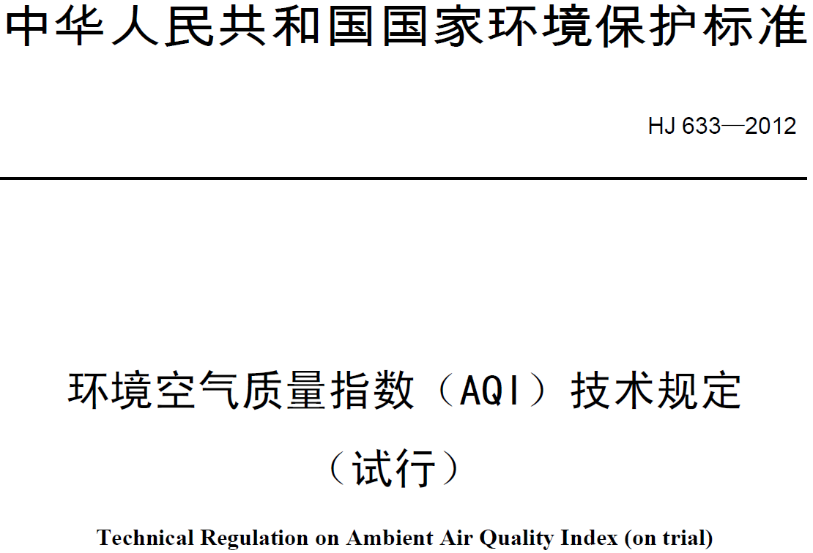
According to the national standard, we classify PM2.5 result into 6 Air Quality Levels
PM2.5 | Air Quality Level | Severity Level | Comment & Suggestion
[0, 35] | Level 1 | Good | Basically no pollution
(35, 75] | Level 2 | Fine | Only sensitive people should reduce outdoor activities
(75, 115] | Level 3 | Mild Pollution | Children, older and sensitive people should reduce outdoor activities
(115, 150] | Level 4 | Mid Pollution | Everyone should reduce outdoor activities
(150, 250] | Level 5 | Heavy Pollution | No outdoor activities for children, older and sensitive people
(250, ) | Level 6 | Severe Pollution | No outdoor activities for everyone
Name of the national standard: “Technical Regulation on Ambient Air Quality Index”
Issued by: Ministry of Ecological Environment of the PRC
Release date: Feb. 29th, 2012
Effective date: Jan. 1st, 2016

Slide 6
Agenda
B
Data preprocessing

Slide 7
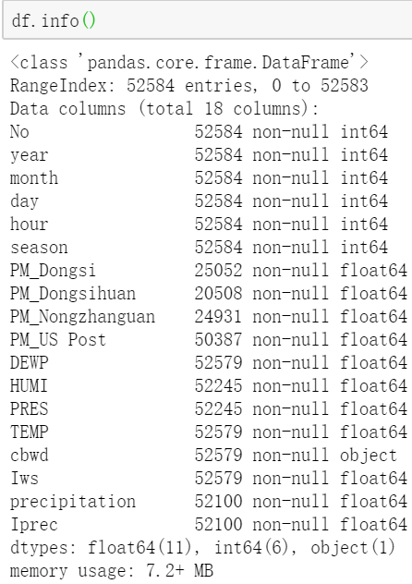
Original Data has 52,584 rows and 18 columns
The time period for this data is between Jan 1st, 2010 to Dec 31st, 2015. Missing data are denoted as NA.
No: row number
year: year of data in this row
month: month of data in this row
day: day of data in this row
hour: hour of data in this row
season: season of data in this row
PM: PM2.5 concentration (ug/m^3)
DEWP: Dew Point (Celsius Degree)
TEMP: Temperature (Celsius Degree)
HUMI: Humidity (%)
PRES: Pressure (hPa)
cbwd: Combined wind direction
Iws: Cumulated wind speed (m/s)
precipitation: hourly precipitation (mm)
Iprec: Cumulated precipitation (mm)

Slide 8
Data preprocessing
We try several ways of imputation to increase the model accuracy, however no imputation can effectively improve the result and most time the result even get worse;
Eventually we decide to drop every row if including missing value;
Handing Missing Value
Encoding Categorical Features
We import LabelEncoder from sklearn.preprocessing to encoding categorical features ‘cbwd’ (Combined wind direction)
We import SelectFromModel from sklearn.feature_selection to select most relevant features including 'day', 'hour', 'PM_Dongsi', 'DEWP', 'HUMI', 'PRES', 'TEMP', 'cbwd', 'Iws'
Feature Selection
Normalization
???

Slide 9
Place Holder: Correlation plot

Slide 10
Place Holder: Final Data Set

Slide 11
Agenda
C
Modeling and result display

Slide 12
Place Holder: KNN

Slide 13
Place Holder: Random Forest

Slide 14
Place Holder: Gradient Boosting

Slide 15
Place Holder: result tables and conclusion

Slide 16
Agenda
D
Insight Sharing

Slide 17
Basic Questions to be answered
Did the air environment become better on a year-over-year(YoY) basis from 2010 to 2015?
Which month has the overall best (worst) air quality?
Which hour has the overall best(worst) air quality?
Did political conference has impact over air quality?
What’s the best(worst) time to have outdoor activities in Beijing

Slide 18
Insight sharing
Did the air environment become better on a year-over-year(YoY) basis from 2010 to 2015?
Place Holder: Level percentage change bar graph based on YoY

Slide 19
Insight sharing
Which month has the best air quality?
Which month has the worst air quality?
Place Holder: Level percentage change bar graph on month basis

Slide 20
Insight sharing
Which hour has the overall best air quality?
Which hour has the overall worst air quality?
Place Holder: Level percentage change bar graph on hour basis

Slide 21
Insight sharing
Did political conference in Beijing has impact over air quality?
Place Holder: 3月-4月两会期间指数百分比/3月-4月且两会结束的指数百分比

Slide 22
Insight sharing
What’s the best(worst) time to have outdoor activities in Beijing
Best time: which month, which our
Worst time: which month, which our
If significant political conference, enjoy every minutes

